Slide 1
Extension and Evaluation of a Sequence Detection System in Wireless Sensor Networks

Slide 2
Intension
Large scaled sensor networks
  Sequence/Location is important
Dynamically detect sequence of sensor modules
  Measurement data can be bound to location

Slide 3
System overview 1
Node 1
Node 2
Node 3
Node 4
Each node transmit broadcast
  Other nodes measure RSS
Transmit on several frequencies for precision
Measurment data processing

Slide 4

System overview 2
Node 1
Master Node
Node 2
Node 3
Node 4
Data collection to master node
Processing data/measurements
  Either on node
  Or on connected PC
Send results to PC

Slide 5
Current implementation
Developed by Onur Ergin
Based on TinyOS and “tmote” sensor modules
Dynamically detect and handle nodes in range
Limitations
  Own data collection protocol doesn't perform well
  System not intended for larger sensor meshes
  Slow in larger networks due to waiting

Slide 6
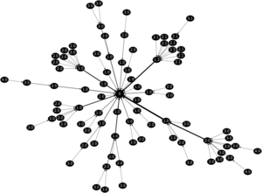
Project Plan
Based on TinyOS and “tmote” sensor modules
Coding from scratch
Improvements/Extesion to old code
  Use standardized protocols
    CTP
    Dissemination
  Try to improve wait times for faster measurements
    Especially on large sensor meshes

Slide 7

Hardware
Microprocessor
Sensors
  For measurement
802.15.4 Wireless
  Several frequencies
USB
  Easy programming
  Simple serial access

